Slide 1
雲端計算
Cloud Computing
Lab - Google App Engine

Slide 2
Agenda
Introduction
  What is Google App Engine?
Installation
  How to start?
Lab
  What do we do?
API
  How to complete it?

Slide 3
Introduction
Overview
Concept

Slide 4

Google App Engine
Google app engine (GAE) is platform as a service (PaaS) in cloud-computation system.
In April 2008, it was first released as a beta version with Python as a programming language.
Currently, the support programming language are Python 2.5 and Java 6.

Slide 5
They claim
Google App Engine enables you to build and host web apps on the same systems that power Google applications.
Google App Engine is a platform for developing and hosting web application in Google-managed data center.
- Google
- Wikipedia

Slide 6
Goal of GAE
GAE lets you run your web applications on Google’s infrastructure.
GAE designs goals:
  Make the system easy to use.
  Make it easy to scale.
  Make it free to get started.
GAE also provides a App Engine SDK that support programmers developing in their computer.

Slide 7

And more
You do not need to purchase, maintain, and manage all of infrastructures.
You just upload your application, and it is ready to serve your users.
There are no set-up costs and recurring fees, you only pay for what you use.

Slide 8
Benefits
GAE provides an infrastructure for running web apps
  It means that we're focused, specifically on web applications.
  Making web services easy to run, easy to deploy, and easy to scale.
GAE do not run arbitrary compute jobs, also do not give a raw virtual machine.
Instead, GAE provide a way for you to package up your code, specify how you want it to run in response to requests, and then we run and serve it for you.

Slide 9
More benefits
Need not to purchase
Hosting service
Need not to build data center
Free domain name service
Scalability
Pay as you go
Need not to manage
Easy to initial

Slide 10

Free your mind

Slide 11
Introduction
Overview
Concept

Slide 12


Sketch
HTTP / HTTPS
Web interface
URL fetch or E-mail
Browser
Sandbox
Request
Datastore
Memcache
Runtime
environment
transactions
Response
Result
Web page
Schedule routine
More services
Static Storage

Slide 13
Sketch
HTTP / HTTPS
Web interface
URL fetch or E-mail
Browser
Sandbox
Request
Datastore
Memcache
Runtime
environment
transactions
Response
Result
Web page
Schedule routine
More services
Static Storage

Slide 14

Sandbox
Sandbox is a security mechanism for separating running programs and often used to execute untested programs.
Applications run in sandbox that provides limited access to the underlying operating system.

Slide 15
Sandbox
Sandbox is independent of the hardware, operating system and physical location of the web server.
  Access other computer only on the Internet through the provided URL fetch.
  Other computer can only connect to GAE application by making HTTP (or HTTPS) requests.
Application also cannot write to the file system, only can read which upload with application code.
  App must use the GAE datastore that persists between requests.

Slide 16
Runtime Environment
GAE provides two runtime environment, Python and Java, which can be used to design web services.
GAE includes rich APIs and tools for web application development.
In general, GAE provides standard library, like JRE standard library or Python 2.X standard library.

Slide 17
Sketch
HTTP / HTTPS
Web interface
URL fetch or E-mail
Browser
Sandbox
Request
Datastore
Memcache
Runtime
environment
transactions
Response
Result
Web page
Schedule routine
More services
Static Storage

Slide 18
Storage space
GAE provide two type of storage space
  Static
  Dynamic
Static storage space cannot be modified when application running.
Dynamic storage space usually be used as a memory cache or disks.

Slide 19
Datastore
GAE provides a dynamic storage space, called datastore, which is based on a powerful distributed data storage.
Datastore is a schemaless object storage space, with a query engine and atomic transactions.
Datastore provides robust scalable data storage for your web application.

Slide 20
Datastore
Datastore stores data entities with properties, organized by application-defined kinds.
Datastore can perform queries over entities of the same kind, with filters and sort orders on property values and keys.
The datastore can execute multiple operations in a single transaction, and roll back the entire transaction if any of the operations fail.

Slide 21
Sketch
HTTP / HTTPS
Web interface
URL fetch or E-mail
Browser
Sandbox
Request
Datastore
Memcache
Runtime
environment
transactions
Response
Result
Web page
Schedule routine
More services
Static Storage

Slide 22

Computation
GAE supports the computation ability with
  1.2 GHz Intel x86 CPU ability per unit per second.
  Update the index would cost more CPU times.
  Write is cost five times of read.
  Each query cost the same CPU time.
GAE is not suitable for high-computation jobs for above limitations.
  Need not to have a high computation ability
  for web service.

Slide 23
Schedule Service
GAE allows you to configure regularly scheduled tasks that operate at defined times or regular intervals.
GAE can perform background processing by inserting tasks into a queue.
GAE provides schedule services that can
  Reduce the cost of CPU time
  Modular
  Periodically execute some functions.
  Execute some functions repetitively.

Slide 24
Sketch
HTTP / HTTPS
Web interface
URL fetch or E-mail
Browser
Sandbox
Request
Datastore
Memcache
Runtime
environment
transactions
Response
Result
Web page
Schedule routine
More services
Static Storage

Slide 25

URL Fetch
GAE can communicate with other applications or access other resources on the web by fetching URLs.
  Download web page and images.
  Interact with other web site.
But URL Fetch has some limitations
  Each request/response must finish under 30 seconds.
  Only on HTTP/HTTPS

Slide 26
Interaction
Interaction between GAE and web site must follow the HTTP protocol.
  Method of HTTP request.
  Payload of each request.
  Status and content of response message.
  More important, like a human.
Some web site does not like ‘robot’ to access.
  Limit the request per minute.
  Reject and recode the wrong request method.
  Send some check messages.

Slide 27
Sketch
HTTP / HTTPS
Web interface
URL fetch or E-mail
Browser
Sandbox
Request
Datastore
Memcache
Runtime
environment
transactions
Response
Result
Web page
Schedule routine
More services
Static Storage

Slide 28
Other Services
OAuth
  A protocol that allows a user to grant a third party limited permission to access a web application on user behalf, without sharing user credentials
XMPP
  An app can send and receive instant messages to and from any XMPP-compatible instant messaging service.
Multitenancy
  The Namespaces API in Google App Engine makes it easy to compartmentalize your Google App Engine data

Slide 29
Installation
Prepared work
  Install GAE
  An example
  Expected warning

Slide 30


Prepared
Google App Engine (GAE)
  Run your web apps on Google’s infrastructure.
  Easy to build, easy to maintain, easy to scale.
Support two programming Language
  Python
  Java
www.python.org/
www.java.com/

Slide 31
Prepared (cont.)
Python
  Python 2.5 or upper version (official support 2.5.x).
    32 bit is recommended
  In Microsoft OS, remember to set Path.
  No Python 3K version.
  http://www.python.org/
Java
  A complete Java 6 runtime environment.
  Java web technology standards, including servlets, JDO and JPA ...etc.
  Install eclipse and GAE-plugin
  http://www.eclipse.org/
  http://dl.google.com/eclipse/plugin/3.X

Slide 32
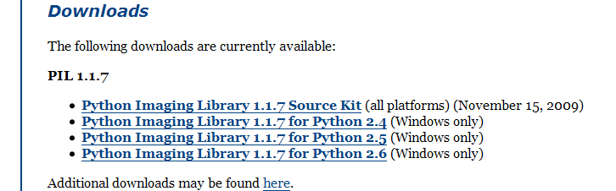
PIL
In GAE, you must install PIL (Python Image Library) for using image API on local machine.
http://www.pythonware.com/products/pil/
Choose one version for the corresponding 32-bit Python

Slide 33
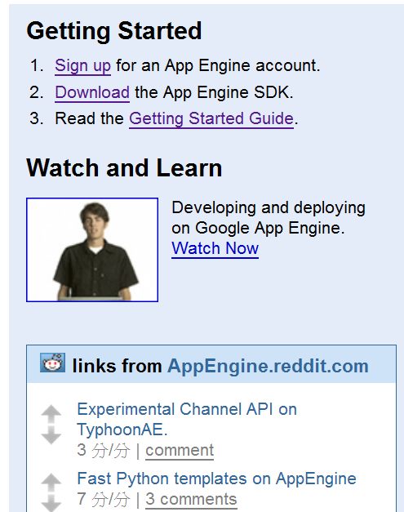
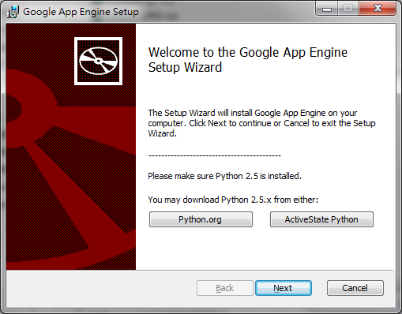
Installation
Go to http://code.google.com/intl/en/appengine/
Download the GAE SDK from internet.
Install the SDK

Slide 34
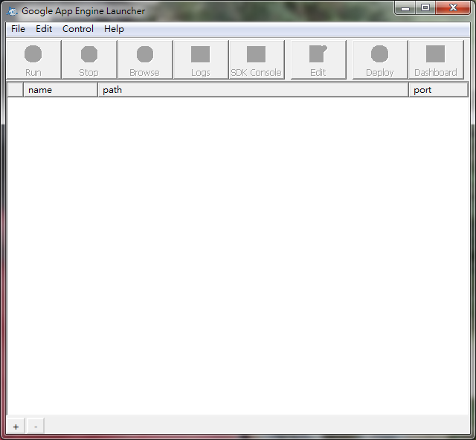
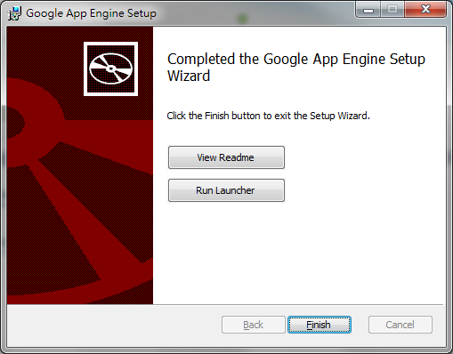
Installation (cont.)
Press next as default setting, or select other what you need.
At the end, you would see
Run GAE Launcher

Slide 35

Test environment
Windows 7 – 32 bits
Python – 2.5.4 32 bit
APP Engine SDK - 1.3.8
  API version: 1
Notepad ++

Slide 36
GAE Account
GAE provides free quotas for user
  1GB stored data
  200 indexes
  141,241,791 API calls / day ; 784,676 calls/min
  46 hours CPU times
  …etc
Prepared
  Google account
  Cell phone

Slide 37
Sign up
Go to http://code.google.com/intl/en/appengine/

Slide 38
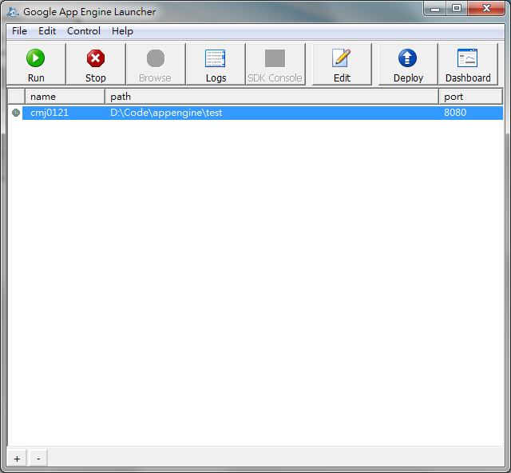
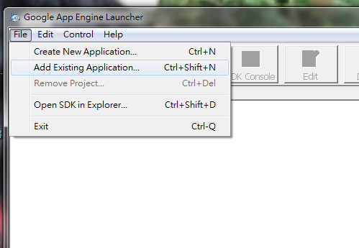
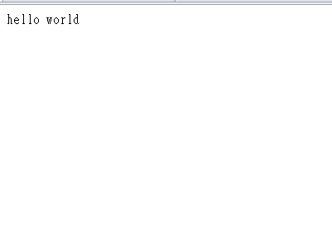
Simple Example
app.yaml
main.py
application: hello
version: 1
runtime: python
api_version: 1
handlers:
- url: /.*
script: main.py
print “hello world”

Slide 39
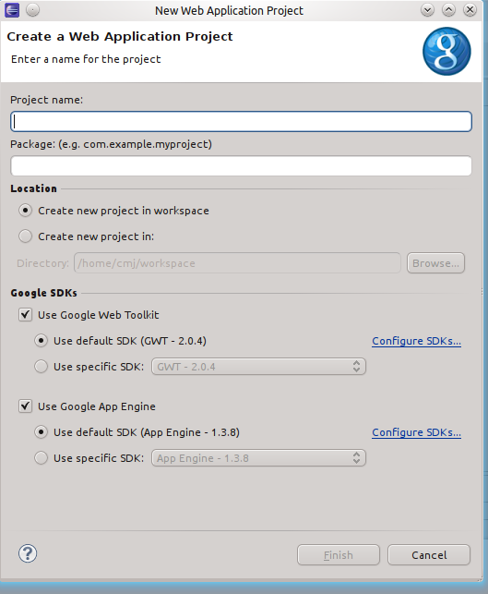
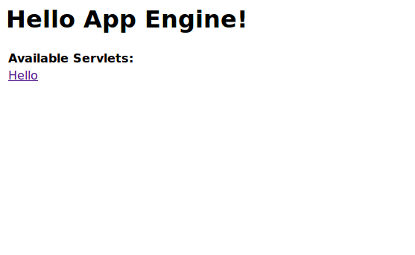
Simple Example (cont.)
File – New – Web Application Project.
Enter the project name which disable GWT.
Run

Slide 40
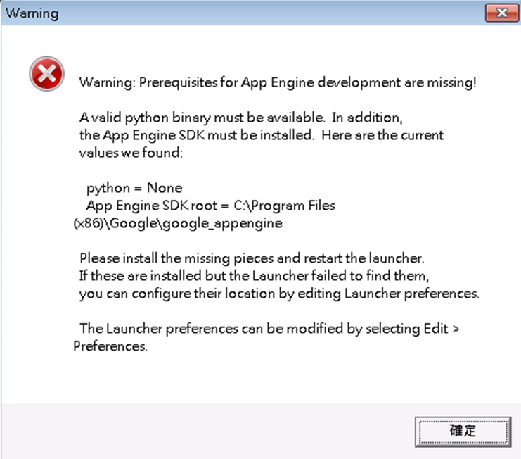
Warning
Make sure that you have set the PATH
for Python
  C:\Python25\
  C:\Python25\Tools\Scripts

Slide 41
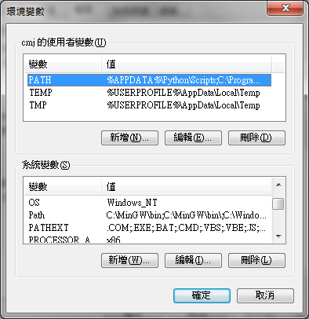
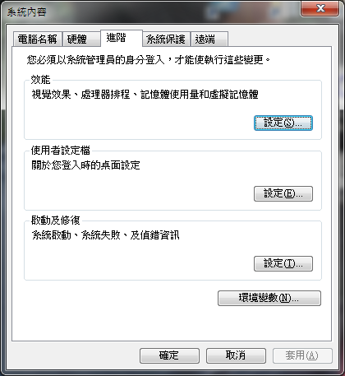
Path
append:
  ;C:\Python25\;C:\Python25\Tools\Scripts

Slide 42
Lab Assignment
Guestbook Prototype

Slide 43
LAb
Real case
Lab requirement

Slide 44
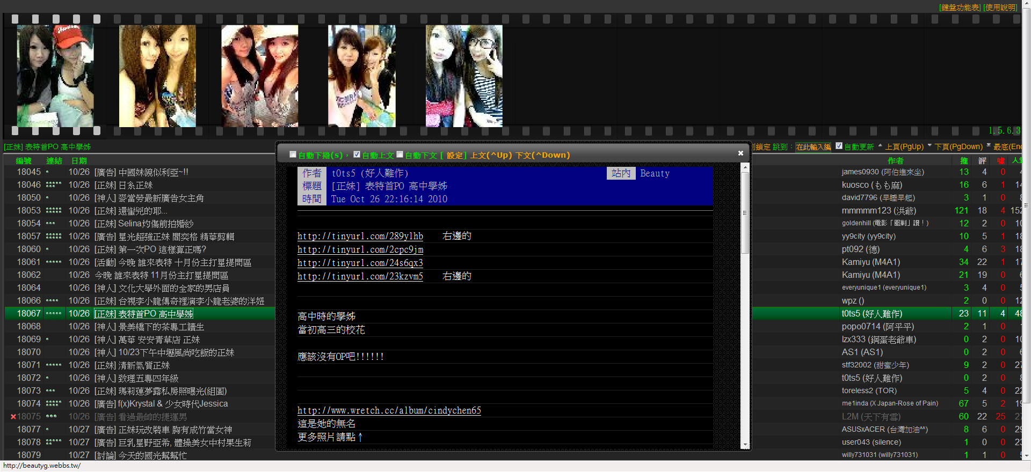
Before we start
表特機 http://beautyg.webbs.tw/
http://www.webbs.tw/share/bgsys

Slide 45
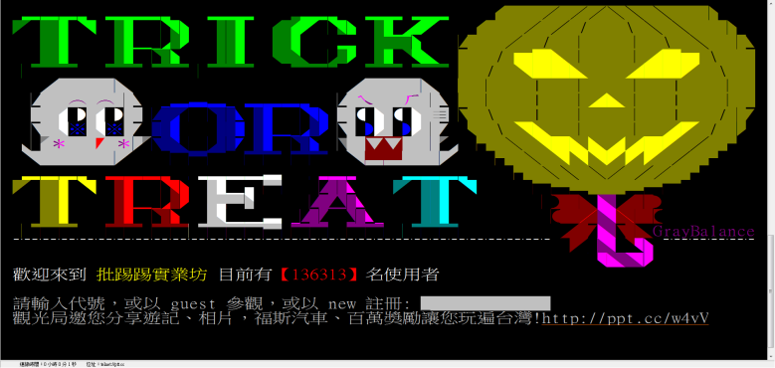
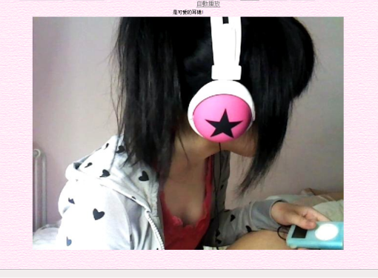
Sketch
BBS Bot
GAE
Web Bot

Slide 46
BBS Bot
Simulate the behavior of user
  Log in.
  Enter beauty board.
  Watch the new post.
Search the newest 100 post from button to top.
  Save each post.
  Translate to module B: Web Bot.
ansi-terminal
  Output agreement of telnet.
  Control codes

Slide 47
Web Bot
Analysis the post
  Separate the album links.
Simulate the behavior of user
  Link to web (include redirect).
  Scan all photos in this link.
  Save all images.
Some web site would ban ‘robot’
  Must be Customized.

Slide 48
GAE
Basic web page of BeautyG
  Web page
  Data center
The web has two parts
  Ajax/JQuart
    Workflow of interface and all web page.
  Flash/ActionScript3
    Communication between web and GAE

Slide 49
LAb
Real case
Lab requirement

Slide 50
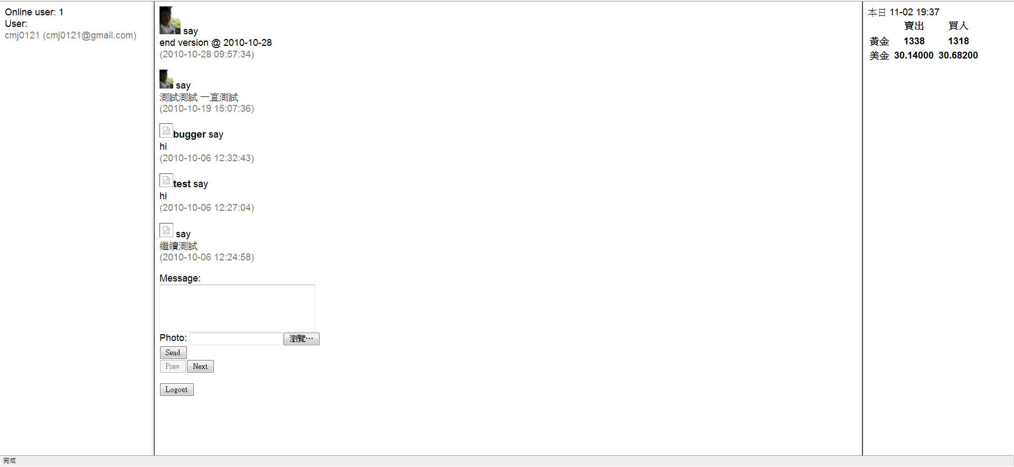
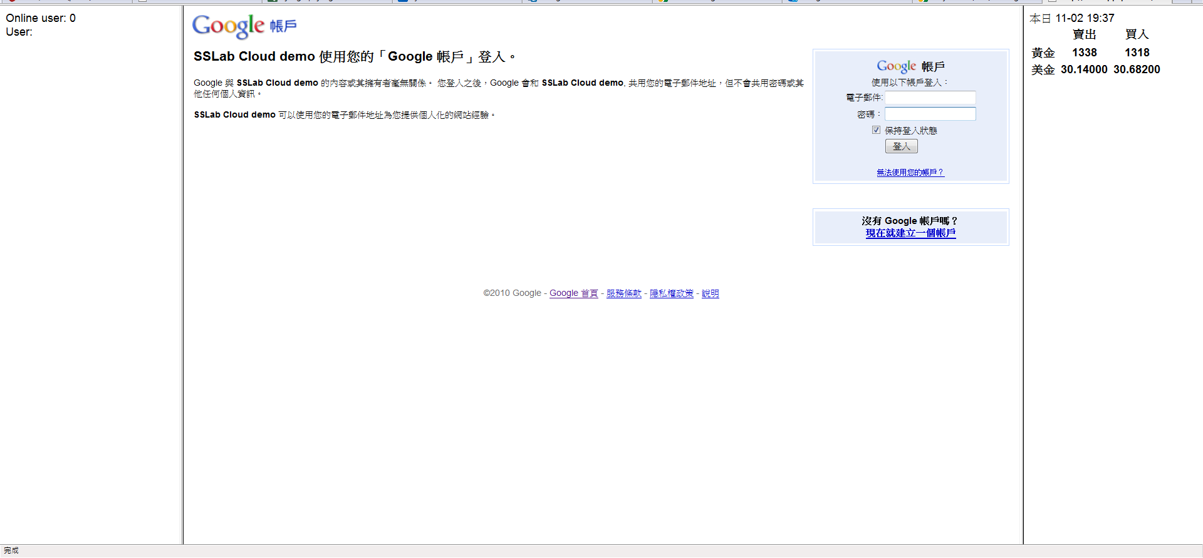
Goal of Lab
http://albumdemo01.appspot.com/
Online-user
Log-in
GuestBook
URL Fetch

Slide 51
Required
GuestBook : two basic functionalities
  Storage
  Query
Membership
  Log-in
  On-line user (ALL users, at least 3 users)
Periodically fetch the content of a web page
  Using “Cron Jobs” to fetch the content of TA web site is the minimal requirement
Other special designs and functionalities (20%)
http://randomhash.appspot.com/

Slide 52
Required (cont.)
Source code
  The project (including all files).
  README file
    Runtime environment & Test environment
    What’s your special designs and functionalities
Hard-Copy Report
  Methodology
    How to
    Screenshot
  Lesson learn & Discussion
# CANNOT run your program will get 0 point
# You can deploy to GAE online, but also need to give the source code
# No LATE is allowed

Slide 53
Next...
Introduction to Python
Sample code
GAE APIs

Slide 54
Python
Python is a general-purpose high-level programming language whose design philosophy emphasizes code readability.
The Zen of Python
  There should be one-- and preferably only one --obvious way to do it.
  Explicit is better than implicit.
http://www.python.org/dev/peps/pep-0020/
Notes:
編輯環境

Slide 55
Sketch
Variable
Library
Indent rules
Condition
Loop
Function
Class

Slide 56
Variable
Python variables do not have to be explicitly declared to reserve memory space.
The declaration happens automatically when you assign a value to a variable.
Answer = True # Boolean
Counter = 100 # An integer
Length = 30.1 # A float
Nane = “John” # A string
List = [1, 2 , 3 ] # A list
Dictionary = {‘A’:1, ‘B’: 3} # A dictionary

Slide 57
Library
Python has many libraries, like standard library, GUI, image, network, … etc.
import facebook
from facebook import Facebook
facebook.py
class Facebook():
…
APP

Slide 58
Indent rules
Python does not use { … } to segment the codes
Instead, Python uses indent rule.
if x is 10 and y is ‘a’:
statement
elif x is not 100 or y is ‘b’:
statement
class fun(self, var1, var 2):
statement…
# more statement
return ref1, ref2

Slide 59
Condition
Python uses many condition statement
  if, else, elif, is, not, and, or,…etc.
if x is 10 and y is not ‘a’: # x=10 and y=/= ‘a’
statement
elif x is not 100 or y is ‘b’: # x =/= 100 or y=‘b’
statement
else: # else
statement

Slide 60
Loop
For loop
While loop
for x in range(10): # loop 10 times
some functionality
for x in List: # sequentially use elms. in List
some functionality
while x is True:
do something
…

Slide 61
Function
Python uses def to declare the function.
def function_1(self, param ):
do something
…
return A, B, … etc;
A, B = function_1( param )
A
B
param
Function

Slide 62
Class
Python’s class mechanism adds classes to the language with a minimum of new syntax and semantics.
class Model_1( inhert ):
def __init__(self): # initialize
self.a = 1 # global var.
A = ‘a’ # local var.
def fun_1(self): # function 1
self.a = 2
A = ‘b’

Slide 63
Sample
# Bubble Sort
LIST = [1,7,5,6,8,3,2,9,4]
for x in range( len(LIST) - 1 ):
for y in range( len(LIST) - x - 1 ):
if LIST[y] > LIST[y+1]:
temp = LIST[y]
LIST[y] = LIST[y+1]
LIST[y+1] = temp
print LIST

Slide 64
Sample Code
Basic Guestbook

Slide 65
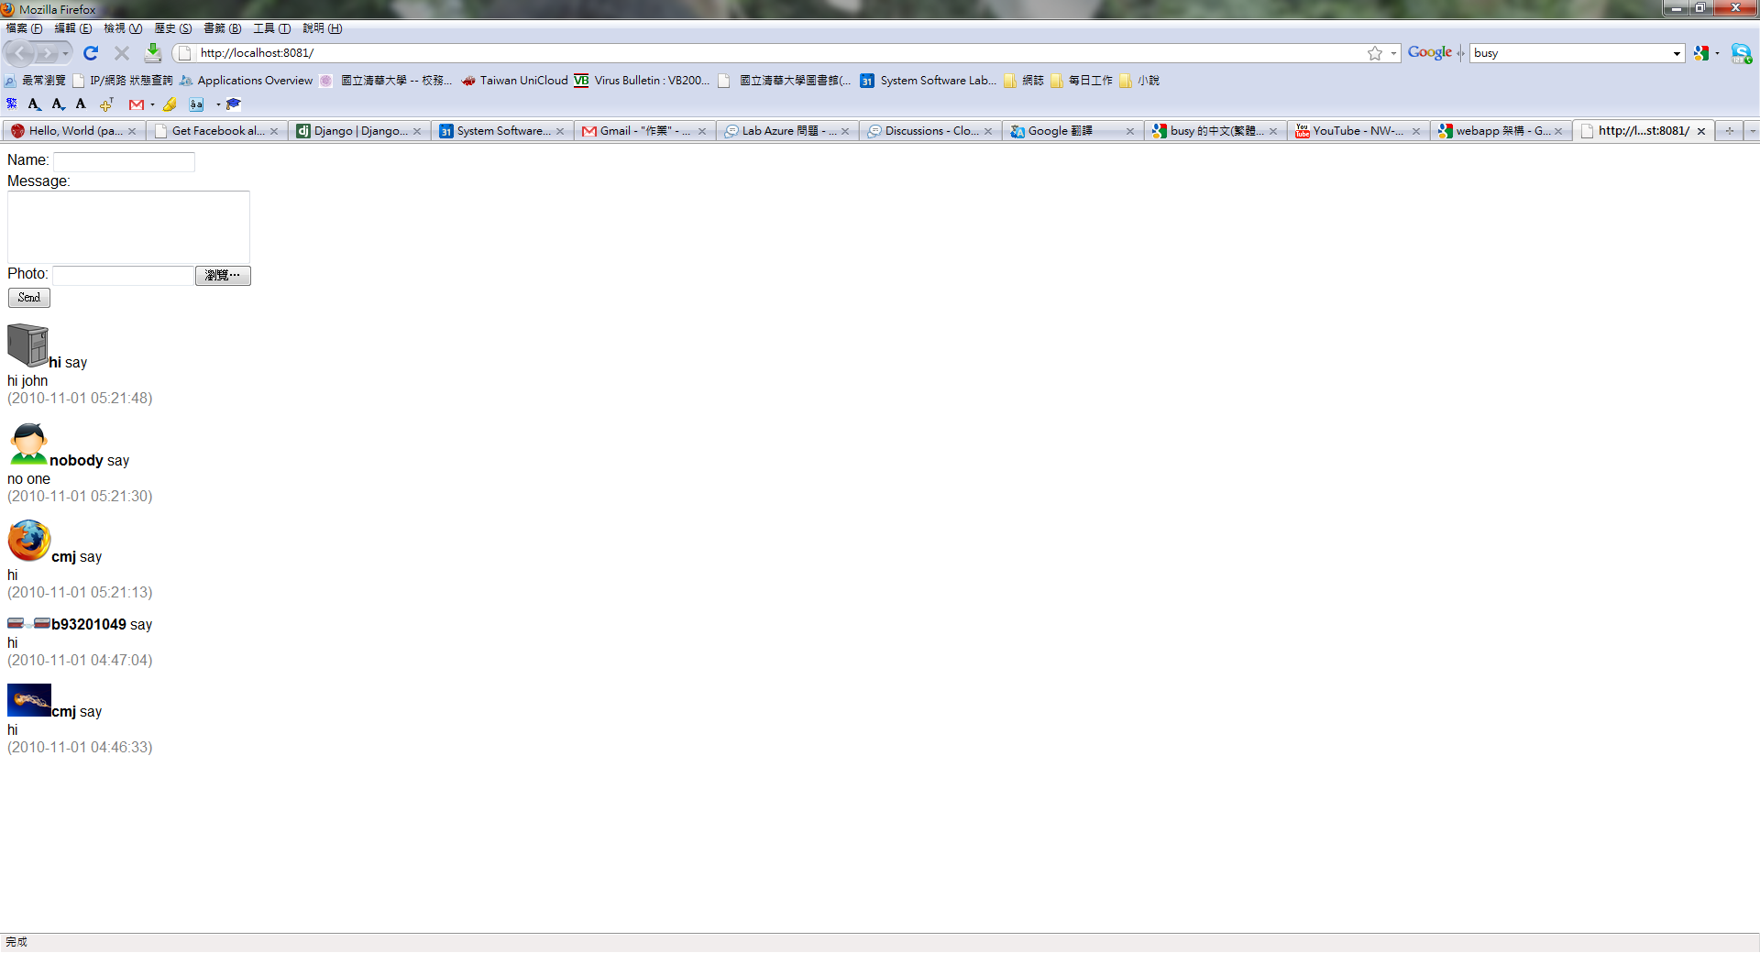
Sample
Input area
Message area

Slide 66
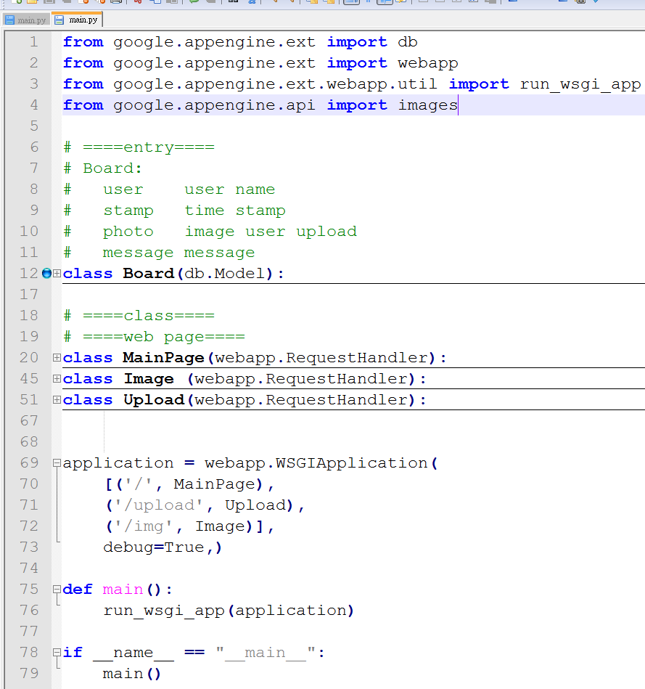
Sample (cont.)
Library
Object
- store instance
Class
- major functionality
Web interface
- easy to build web page

Slide 67
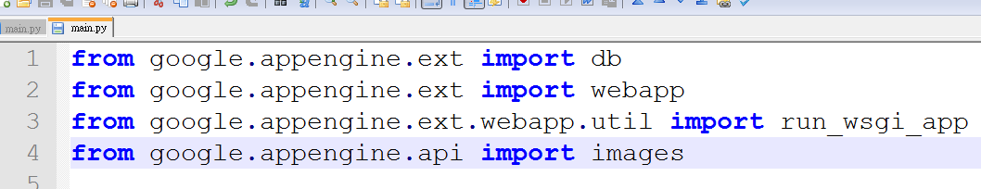
Sample (cont.)
Entity library
  db
Web library
  webapp
  run_wsgi_app
Image library
  images

Slide 68
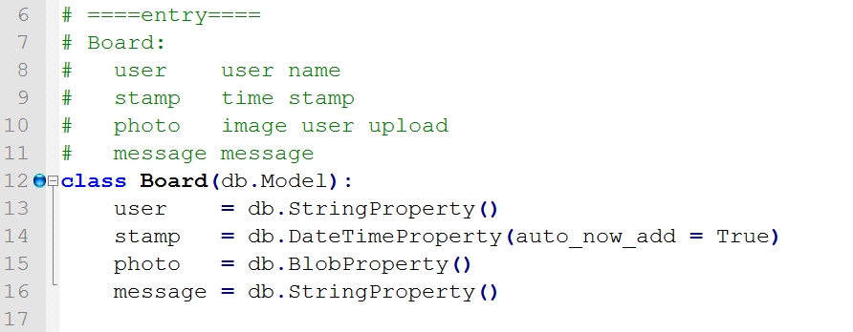
Sample (cont.)

Slide 69
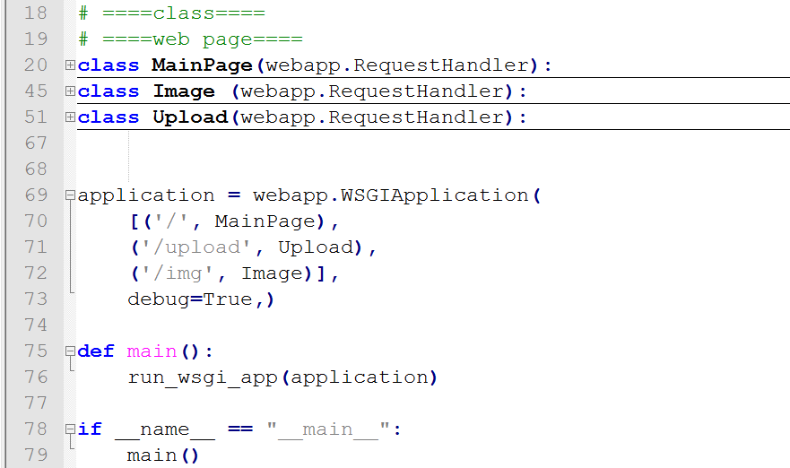
Sample (cont.)
Functionality
Web interface
Main part

Slide 70
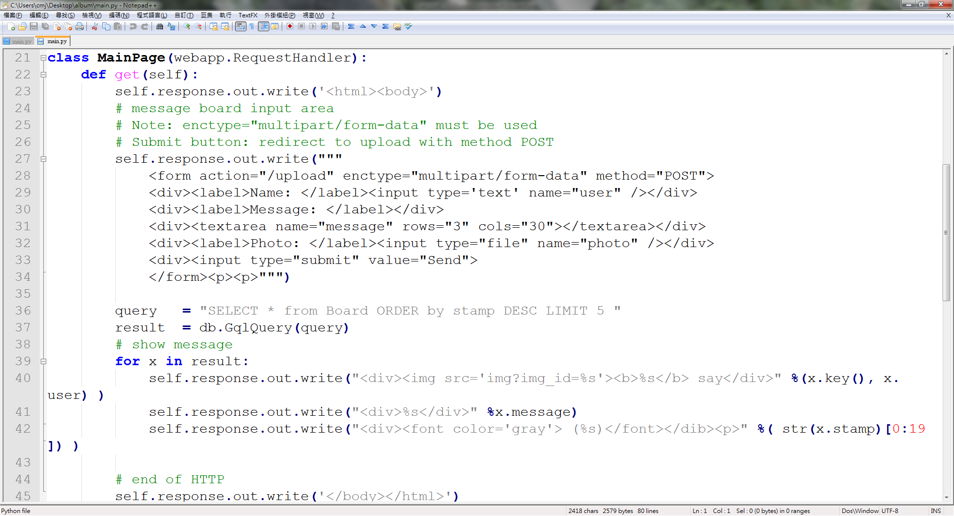
Sample (cont.)
Input area
Query

Slide 71
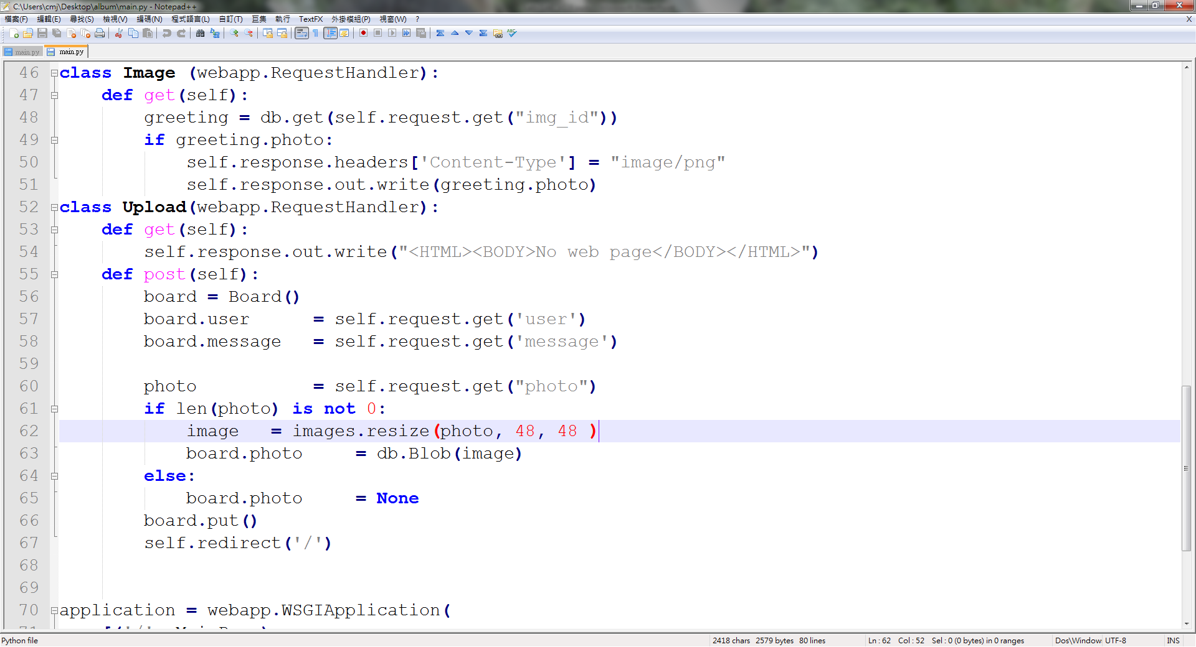
Sample (cont.)
Image link
Upload to GAE datastore

Slide 72
GAE APIs
Storage
Query
Schedule
Communication
Others…

Slide 73

Sketch
Introduction to some functionalities of Google App Engine.
  Storage Space
  Query data
  Schedule routine
  Communication
  Other Services

Slide 74
Storage

Slide 75

Static vs Dynamic
In GAE, storage space can be separated into two parts
  Static
    Static space
    Blobstore
  Dynamic
    Datastore
    Memcache

Slide 76
Static
Static space
  Web service source files
  Configure file
  Background images
Blobstore
  Larger than 1MB file
    Image
    Video or Music
    Execute file
    …etc

Slide 77
Dynamic
Datastore
  Dynamic provisioning which can dynamically insert, update, delete any data on demand.
  Each entity does not large than 1MB
Memcache
  On the usage of a memory cache is to speed up common datastore queries.
  Values can expire from the memcache at any time, and may be expired prior to the expiration deadline set for the value.

Slide 78
Storage Space
Static
Blobstore
Datastore
Memcache

Slide 79
Static
Source codes
  python codes
YAML – (YAML Ain't a Markup Language)
  profile
Static file
  Background image
  .css template
  Javascript source code

Slide 80
Project
my_application/
|
|- app.yaml
|- main.py
|- static_file/
|
|- background.png
|- setting.css

Slide 81
YAML
application: myapp
version: 1
runtime: python
api_version: 1
handlers:
- url: /
script: home.py
- url: /stylesheets
static_dir: stylesheets
- url: /(.*\.(gif|png|jpg))
static_files: static/\1
upload: static/(.*\.(gif|png|jpg))
Script handlers
  The URL pattern, as a regular expression.
  The path to the script, from the application root directory.
static_dir and static_files
  Static files are not available in the application's file system.
Hint:
variable: .*

Slide 82
Storage Space
Static
Blobstore
Datastore
Memcache

Slide 83

Blobstore
In GAE, large file cannot be used in datastore.
Instead, GAE provides blobstore to store large file
  .bmp image
  video
Blobstore can only be used like as a CD.

Slide 84
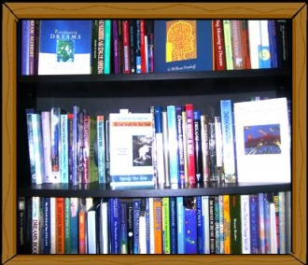

Sketch
Text
Blobstore

Slide 85
Function
from google.appengine.ext import blobstore
upload_url = blobstore.create_upload_url('/upload')
# redirect to /upload
Storage space
class __BlobInfo__(db.Model):
content_type = db.StringProperty()
creation = db.DataTimeProperty()
filename = db.StringProperty()
size = db.IntegerProperty()

Slide 86
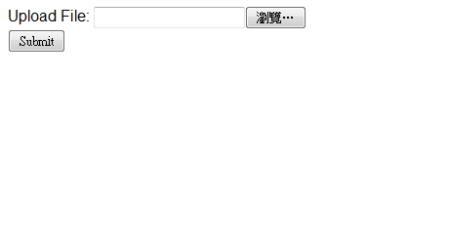
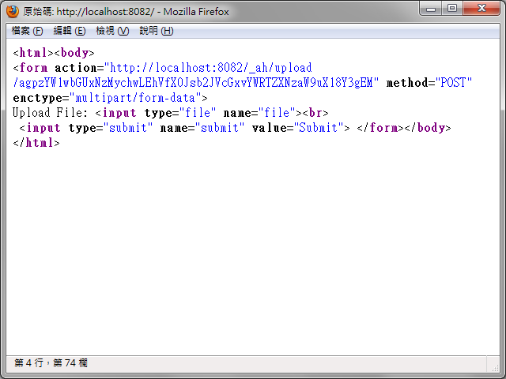
Sample

Slide 87
Sketch
/
Create upload URL
Submit something to this URL
Redirect to /upload
/upload
/serve
Parse upload file
Redirect to /serve?XXXX
1.Send file

Slide 88
/
class MainHandler(webapp.RequestHandler):
def get(self):
upload_url = blobstore.create_upload_url('/test')
self.response.out.write('<html><body>')
self.response.out.write(
'<form action="%s" method="POST" enctype="multipart/form-data">'
% upload_url)
self.response.out.write(
"""Upload File: <input type="file" name="file"><br>
<input type="submit“ name="submit" value="Submit">
</form></body></html>""")

Slide 89
/upload & /serve
/upload
class UploadHandler(blobstore_handlers.BlobstoreUploadHandler):
def post(self):
upload_files = self.get_uploads('file') # 'file' is file upload field in the form
blob_info = upload_files[0]
self.redirect('/serve/%s' % blob_info.key())
/serve
class ServeHandler(blobstore_handlers.BlobstoreDownloadHandler):
def get(self, resource):
resource = str(urllib.unquote(resource))
# e.g. unquote(‘abc%20def’) = ‘abc def’
blob_info = blobstore.BlobInfo.get(resource)
self.send_blob(blob_info)

Slide 90
Storage Space
Static
Blobstore
Datastore
Memcache

Slide 91

Entity
In GAE, every object is called entity in datastore.
Each entity has one or many properties that can describe the instance.
Age:= 1
Status:= sleep
Name:= jean
Weight := 1.5KG
photo
entity := Cat

Slide 92
Instance
GAE supports a fixed set of value types for properties.
The constructor of the property could define as
  Name
  Default value
  Required default
  Choice list
  Indexed
Properties
Text
Blob
…etc
List
Date/Time
E-mail
Boolean
Integer
String

Slide 93
Example: cat
from google.appengine.ext import db
class Cat(db.Model):
name = db.StringProperty(default=‘cat’)
age = db.IntegerProperty(required=True)
weight = db.IntegerProperty( indexed=False)
status = db.StringProperty( choices = [‘sleep’, ‘eat’, ‘play’] ) photo = db.BlobProperty()
Name has a string property which default value is ‘cat’
Age has a integer property which have to a value,
otherwise GAE would throw an exception
Weight has a integer property which GAE
would not index it.
Status has a string property which only
can be chosen by three choice.
Photo is a blob property which can store a binary file

Slide 94
Property
Each property has its limitation
  Short string has to be less than 500 characters in length.
  List cannot be a empty list (Python only).
  Text and Blob have to be less than 1MB in size.
In every entity, there is an important property called key.
Key is a special entity which is one and only one property in each entity.
  app - application name which store this instance.
  kind - instance type by string
  id - instance id
  name - instance name

Slide 95
Key
Entity
Property A
Property B
App
Key
Kind
Name
Id

Slide 96
Property
app = ‘Taiwan’
kind = ‘Cat’
name = ‘F.catus.Taiwan.taipei.2008-01-21.100 ‘
id = agdjb3VudGVycgsLEgV3b3JkcxgoDA
Age:= 1
Status:= sleep
Name:=jean
Weight := 1.5KG
photo
entity := Cat

Slide 97



Example: my cat
Cat my_cat(
name = ‘jean’,
age = 2,
weight = 1.5,
status = ‘play’,
photo = ‘image.jpg’)
play
jean
2 years
1.5 KG
my_cat.put()
Key
We do not upload to server!

Slide 98


Insert, Update and Delete
put(), the upload function, is also can be used as a update function.
  put(key) would update the data identified by key value.
Also, GAE can use delete(key) to delete an entity.
  Deleting an entity does not change any Key values in the datastore that may have referred to the entity.
Put
Put(key)
Delete(key)

Slide 99
Storage Space
Static
Blobstore
Datastore
Memcache

Slide 100
Memcache
High performance scalable web applications often use a distributed in-memory data cache.
  many requests make the same query with the same parameters.
  the results do not need to appear on the web site right away.
  only perform the datastore query if the results are absent or expired.

Slide 101
Memcache (cont.)
But Memcache has some limitations
  Maximum to 1MB of total size.
  data should probably be stored in the datastore in addition to the memcache.
  A key can be any size. If larger than 250 bytes, it is hashed to a 250-bytes value before storing or retrieving.
  The "multi" batch operations can have any number of elements, but total size must not exceed 1 MB.

Slide 102
Function
Memcache has many methods
  Set, get, delete, add, replace, offset, incr, and flush.
set(key, value, time=0, min_compress_len=0, namespace=None)
# min_compress_len: Ignored option for compatibility.
get_multi(keys, key_prefix='', namespace=None)
# key_prefix: Prefix to prepend to all keys.
# return a dictionary of the keys
flush_all()
# Deletes everything in memcache.
incr(key, delta=1, namespace=None, initial_value=None)
# Atomically increments a key's value.

Slide 103
Example
from google.appengine.api import memcache
# Add a value if it doesn't exist in the cache, with a cache expiration of 1 hour.
memcache.add(key="weather_USA_98105", value="raining", time=3600)
# Looks up multiple keys from memcache in one operation.
# The returned value is a dictionary of the keys and values.
get_multi(keys=[‘a’,’b’], key_prefix='weather_', namespace=None)
# Atomically increment an integer value.
memcache.set(key="counter", 0)
memcache.incr("counter")
memcache.incr("counter")
memcache.incr("counter")

Slide 104
Query data
Index
GQL (Google Query Language)

Slide 105

Index
Datastore uses indexes for every query your application makes.
  More than one condition of a query.
These indexes are updated whenever an entity changes, so the results can be returned quickly when the app makes a query.

Slide 106
index.yaml
Index also uses YAML
  kind – the kind of the entity for the query.
  properties - a list of properties to include as columns of the index
  ancestor - yes if the query has an ancestor clause
indexes:
kind: Cat
ancestor: no
properties:
- name: name
- name: age
direction: desc
kind: Cat
properties:
- name: name
direction: asc
- name: whiskers
direction: desc

Slide 107
Query data
Index
GQL (Google Query Language)

Slide 108
GQL
GQL is a SQL-like language for retrieving entities or keys from the GAE scalable datastore.
GQL is based on bigtable technique which is a key-value datastore.
GQL does not support the JOIN statement, because it seems to be inefficient when queries span more than one machine.

Slide 109
GQL (cont.)
This shared-nothing approach allows disks to fail without the system failing.
Instead, one-to-many and many-to-many relationships can be accomplished using Reference Property in GAE.
In GQL, the number of results for each query are at most 1000.
Use OFFSET statement can skip many results to find first result you need.

Slide 110
GQL (cont.)
SELECT [* | __key__] FROM <kind>
[WHERE <condition> [AND <condition> ...]]
[ORDER BY <property> [ASC | DESC] [, <property> [ASC | DESC] ...]]
[LIMIT [<offset>,]<count>]
[OFFSET <offset>]
<condition> := <property> {< | <= | > | >= | = | != } <value>
<condition> := <property> IN <list>
<condition> := ANCESTOR IS <entity or key>
Choose the entity type and show the result
Set the condition(s)
Sort the result by the given properties
Limit the numbers of result, and can skip
numbers of results
Conditions

Slide 111
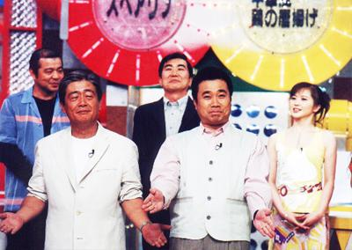
Example
query = “SELECT * from User WHERE age > 10 “ + “
ORDER by birthday DESC”
results = db.GqlQuery(query)
query = “WHERE age > 10 ORDER by birthday DESC”
results = User.gql(query)

Slide 112
Comparison
Compared with MySQL, one of popular of SQL language, GQL has some difference and similar part.
GQL has a high similarity of syntax between MySQL.
  SELECT syntax
  Condition syntax
But there are many differences between GQL and MySQL.

Slide 113

Comparison
The biggest difference is the commands.
  GQL has no privilege commands, like GRANT, FLUSH.
  GQL does not provide friendly commands for operating table.
  GQL does not support some queried commands.

Slide 114
Comparison
GRANT
REVOKE
Privilege
FLUSH
MySQL
Operator
OPTIMIZE
ALTER
LOAD
Query
REPLACE
COUNT
GROUP
JOIN

Slide 115
Schedule routine
Cron jobs
Tasks Queue

Slide 116
Schedule service
GAE provides two types of computation models
  Cron jobs
  Tasks queue
All of two are used for some periodical jobs.
Cron jobs and Tasks are also subject to the same limits and quotas as a normal HTTP request.
  The lifetime of a cron job’s or a task’s execution is limited to 30 seconds.

Slide 117
Schedule routine
Cron jobs
Tasks Queue

Slide 118
Cron
The cron jobs allows you to configure regularly scheduled tasks that operate at defined times or regular intervals.
The cron jobs are automatically triggered by the App Engine Cron Service.
  Update some cached data every 10 minutes.
  Update some summary information every once an hour.
  Send e-mail every day.

Slide 119
cron.yaml
cron:
- description: daily summary job
url: /tasks/summary
schedule: every 24 hours
- description: monday morning mailout
url: /mail/weekly
schedule: every monday 09:00
timezone: Australia/NSW
job
schedule:
time range
("every"|ordinal) (days) ["of" (monthspec)] (time) (synchronized)

Slide 120
Synchronized
By default, an interval schedule starts the next interval after the last job has completed.
Schedule 1
Schedule 2
00:00
24:00

Slide 121
Schedule routine
Cron jobs
Tasks Queue

Slide 122
Task Queue
If an app needs to execute some background work, it may use the Task Queue API to organize that work into small, discrete units, called Task.
The app then inserts these Tasks into one or more Queues.
App Engine automatically detects new Tasks and executes them when system resources permit.

Slide 123
queue.yaml
queue:
- name: default
rate: 1/s
- name: mail-queue
rate: 2000/d
bucket_size: 10
- name: background-processing
rate: 5/s
Default setting
- 5 tasks per second
- 5 bucket size
rate
- The average rate at which tasks are processed on this queue.
bucket_size
- Limits the burstiness of the queue's processing.

Slide 124
Example
from google.appengine.api.labs import taskqueue
class CounterHandler(webapp.RequestHandler):
def post(self):
key = self.request.get('key')
# Add the task to the default queue.
taskqueue.add(url='/worker', params={'key': key})
self.redirect('/')

Slide 125
Communication
URL Fetch

Slide 126
Introduction
App Engine applications can communicate with other applications or access other resources on the web by fetching URLs.
  HTTP and HTTPS requests and receive responses.
You can use the Python standard libraries or GAE library
  urllib, urllib2, or httplib
  urlfetch

Slide 127
Function
fetch( url, # HTTP or HTTPS URL
payload=None, # Body content for POST of PUT
method=GET, # HTTP method
headers={}, # set of HTTP Headers
allow_truncated=False, # machine of truncate response
follow_redirects=True, # up to 5 consecutive redirects
deadline=None) # time out (default: 5, up to 10)
return:
content # return web page
content_was_truncated # truncate or not
status_code # status code
headers # HTTP header
final_url # actual URL returned this response.

Slide 128
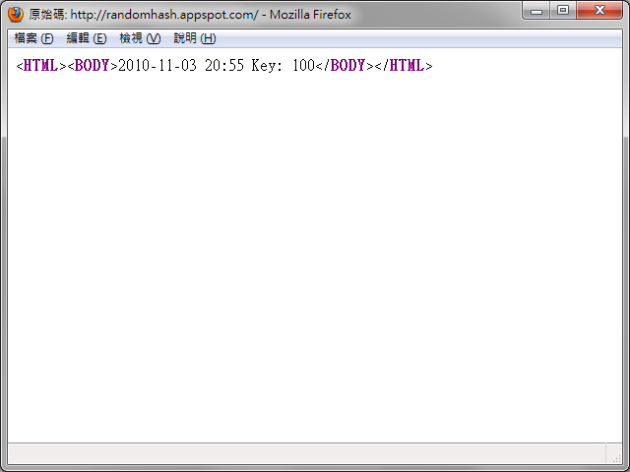
Example
from google.appengine.api import urlfetch
url = "http://www.google.com/"
result = urlfetch.fetch(url)
if result.status_code == 200:
doSomethingWithResult(result.content)
urlfetch
return response

Slide 129
Other Service
User

Slide 130
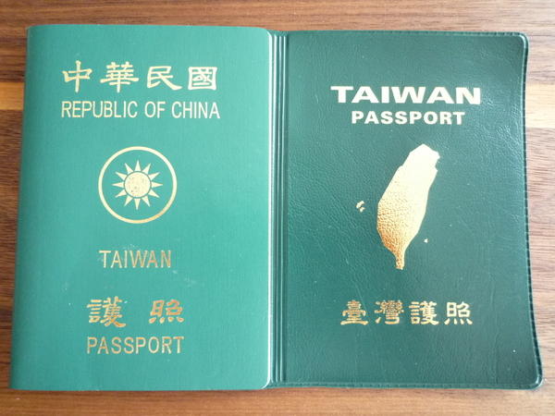
User
App Engine applications can authenticate users who have Google Accounts or OpenID.
An application can detect whether the current user has signed in, and can redirect the user to a sign-in page to sign in or create a new account.

Slide 131
User
An instance of the User class represents a user.
  nickname
  email
  user_id
There are three functions
create_login_url(dest_url=None, _auth_domain=None, federated_identity=None)
# return a URL
create_logout_url(dest_url)
# return a URL
get_current_user()
# return a User object
_auth_domain:
ignored
federated_identity:
OpenID identifier

Slide 132
Example
from google.appengine.api import users
class MyHandler(webapp.RequestHandler):
def get(self):
user = users.get_current_user()
if user:
greeting = ("Welcome, %s! (<a href=\"%s\">sign out</a>)" %
(user.nickname(), users.create_logout_url("/")))
else:
greeting = ("<a href=\"%s\">Sign in or register</a>." %
users.create_login_url("/"))
self.response.out.write("<html><body>%s</body></html>" % greeting)

Slide 133
More Information
Google App Engine
http://code.google.com/intl/en/appengine/
Google App Engine - Tools and Tips
http://code.google.com/intl/en/appengine/tools_tips.html
Sample of Lab
http://albumdemo01.appspot.com/
Simple web page that you need to fetch the content
http://randomhash.appspot.com/
Check the latest announcement on the course website
  http://cs5421.sslab.cs.nthu.edu.tw/

